Slide 1

Interactive Map of SETU Carlow
Gábor Major
Supervisor: Dr Oisin Cawley

Slide 2

The Project
Interactive Map of SETU Carlow Campus
Useful for searching for rooms
Has navigation between points of interest

Slide 3



Users
Guest Visitors
Peer Mentors
New Students

Slide 4

User Features
View Campus Map
View Room information
Allows the user to move, rotate, zoom, and look at the whole campus map.
Select a room and view information related, such as name, number, and description.

Slide 5

User Features
Search for Rooms and Buildings
Navigate to Room
The user starts typing into a search box and a list of potential rooms and buildings is shown that they may be looking for.
Allows the user to select starting and end positions, and a path is calculated between them.

Slide 6
Admin Features
Modify Room Information
Modify Map Waypoints
Allows the Admin to change the information of the rooms such as the room name, number, description et cetera.
Modifying the location and further properties of the map waypoints is also available to the Admin.

Slide 7




4 Technology Parts
01
03
OS: Android, Web
Pathfinding:
A* Algorithm
02
04
Development Framework: Godot Game Engine
Backend: Firebase

Slide 8
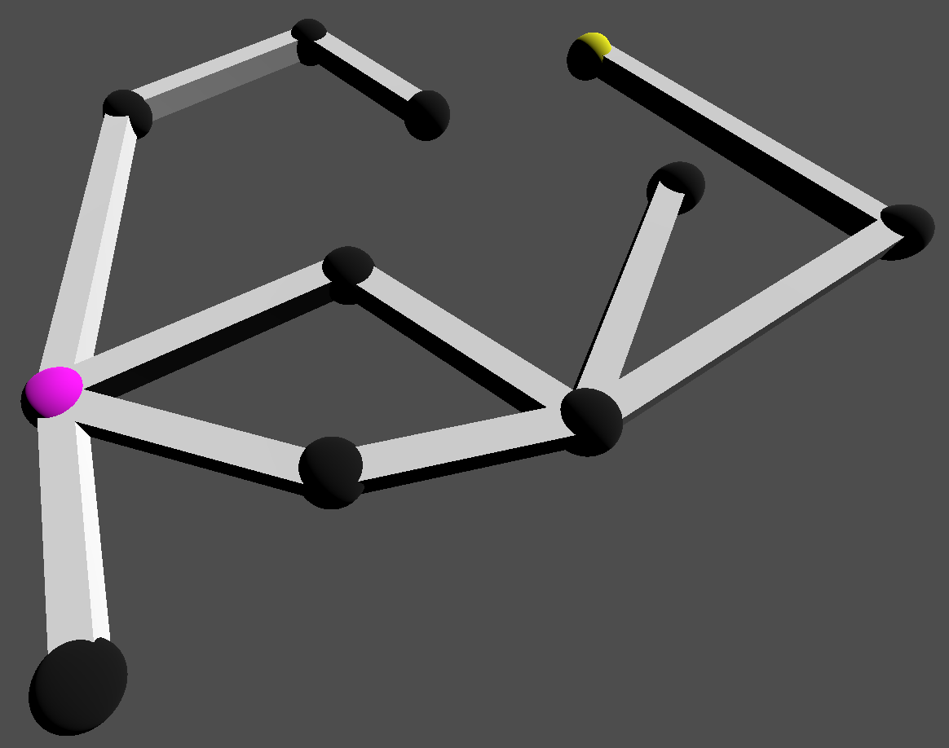
Progress
Collection of connected nodes.
Starting node: Pink
Unchecked nodes: Black
End node: Yellow

Slide 9
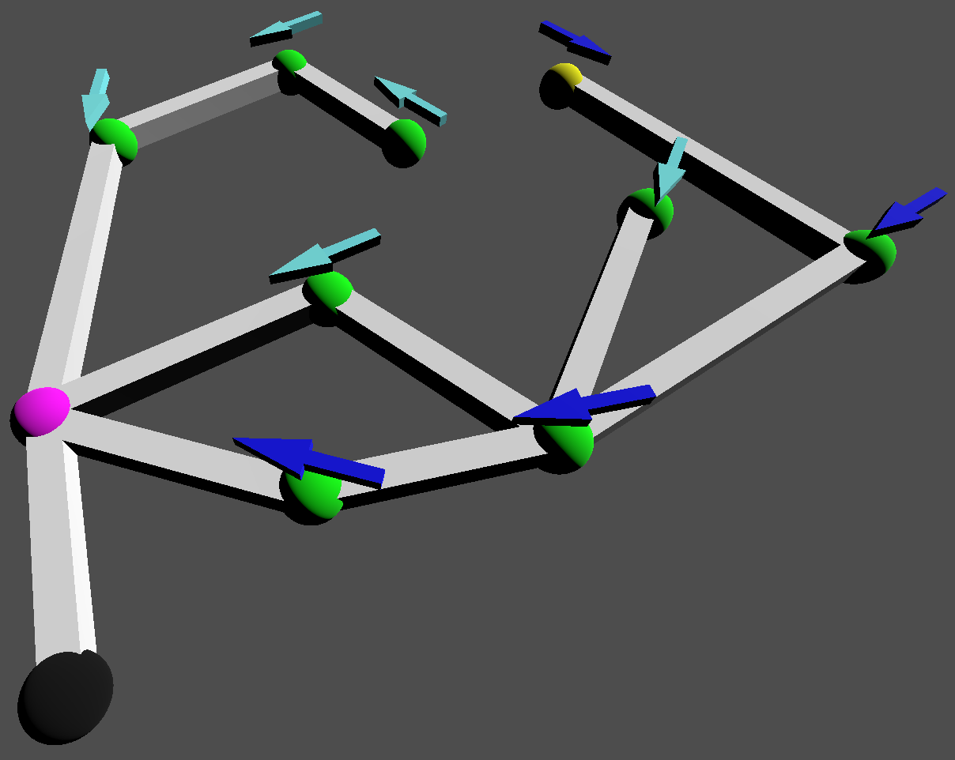
Progress
After running algorithm, shortest path found.
Arrows indicate previous node.
Checked nodes: Green
Dark blue arrows show shortest path.

Slide 10
References
A* Pathfinding: https://www.youtube.com/watch?v=-L-WgKMFuhE
Generic Icons: https://www.flaticon.com/
Technologies Mentioned:
Android – https://www.android.com/
HTML5 – https://html.spec.whatwg.org/multipage/
Godot – https://godotengine.org/
Firebase – https://firebase.google.com/

Slide 11
Thank You
Questions?

